Slide 1

https://www.uni-goettingen.de/en/48115.html
Unless I explicitly state otherwise, images and cartoons are created using ChatGPT.
You may use this material free of charge under the terms of the CC BY license. This requires that you provide appropriate attribution to the author: W. Link, University of Goettingen, Germany.
In a few cases, individual images, photographs, or similar material may be subject to a more restrictive Creative Commons license. Where this applies, it is explicitly indicated, and you must comply with the stated license terms for those items.
Please check the license information carefully before reuse. Responsibility for complying with the applicable license terms rests entirely with you.
Pop_Gen Ch-11[LD III]
Population Genetics; Exploitation of LD for MAS (Marker-assisted Selection)
1

Slide 2
Sequential Number: #12
UNPLAB-PopGen_Ch-11[MAS]
2

Slide 3
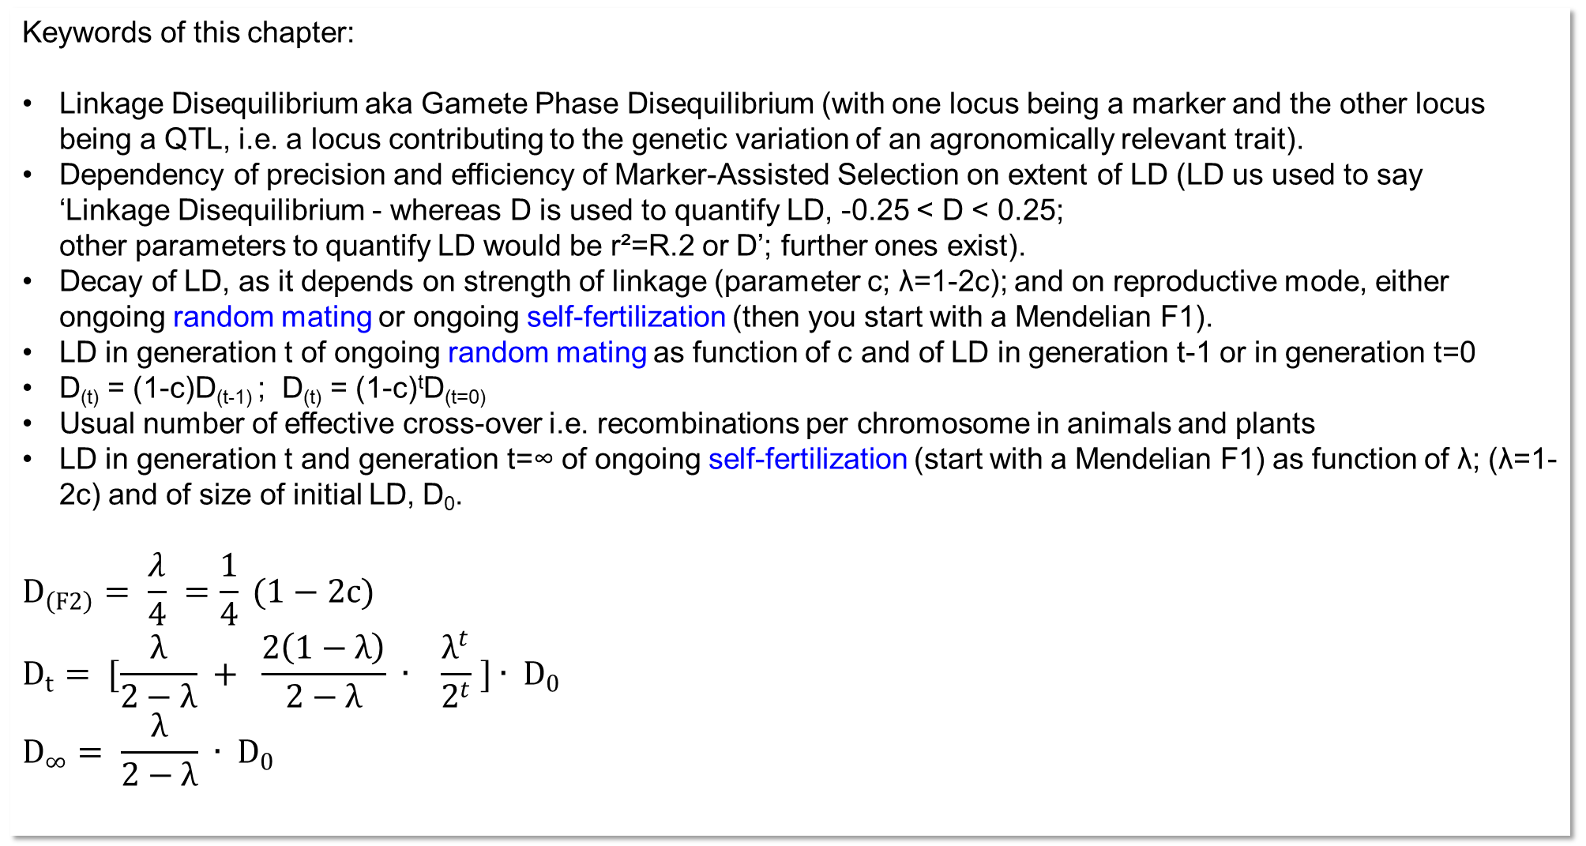
Keywords of this chapter:
Linkage Disequilibrium aka Gamete Phase Disequilibrium (with one locus being a marker and the other locus
being a QTL, i.e. a locus contributing to the genetic variation of an agronomically relevant trait).
Dependency of precision and efficiency of Marker-Assisted Selection on extent of LD (LD us used to say
‘Linkage Disequilibrium - whereas D is used to quantify LD, -0.25 < D < 0.25;
other parameters to quantify LD would be r²=R.2 or D’; further ones exist).
Decay of LD, as it depends on strength of linkage (parameter c; λ=1-2c); and on reproductive mode, either ongoing random mating or ongoing self-fertilization (then you start with a Mendelian F1).
LD in generation t of ongoing random mating as function of c and of LD in generation t-1 or in generation t=0
D_{(t)} = (1-c)D_{(t-1)} ; D_{(t)} = (1-c)^{t}D_{(t=0)}
Usual number of effective cross-over i.e. recombinations per chromosome in animals and plants
LD in generation t and generation t=∞ of ongoing self-fertilization (start with a Mendelian F1) as function of λ; (λ=1-2c) and of size of initial LD, D₀.
$$D_{\left(F2\right)}= \frac{λ}{4} =\frac{1}{4} (1−2c)$$
$$D_{t}= [\frac{λ}{2−λ} + \frac{2\left(1−λ\right)}{2−λ} ∙ \frac{λ^{t}}{2^{t}} ]∙ D_{0}$$
$$D_{∞}= \frac{λ}{2−λ} ∙ D_{0}$$
3

Slide 4
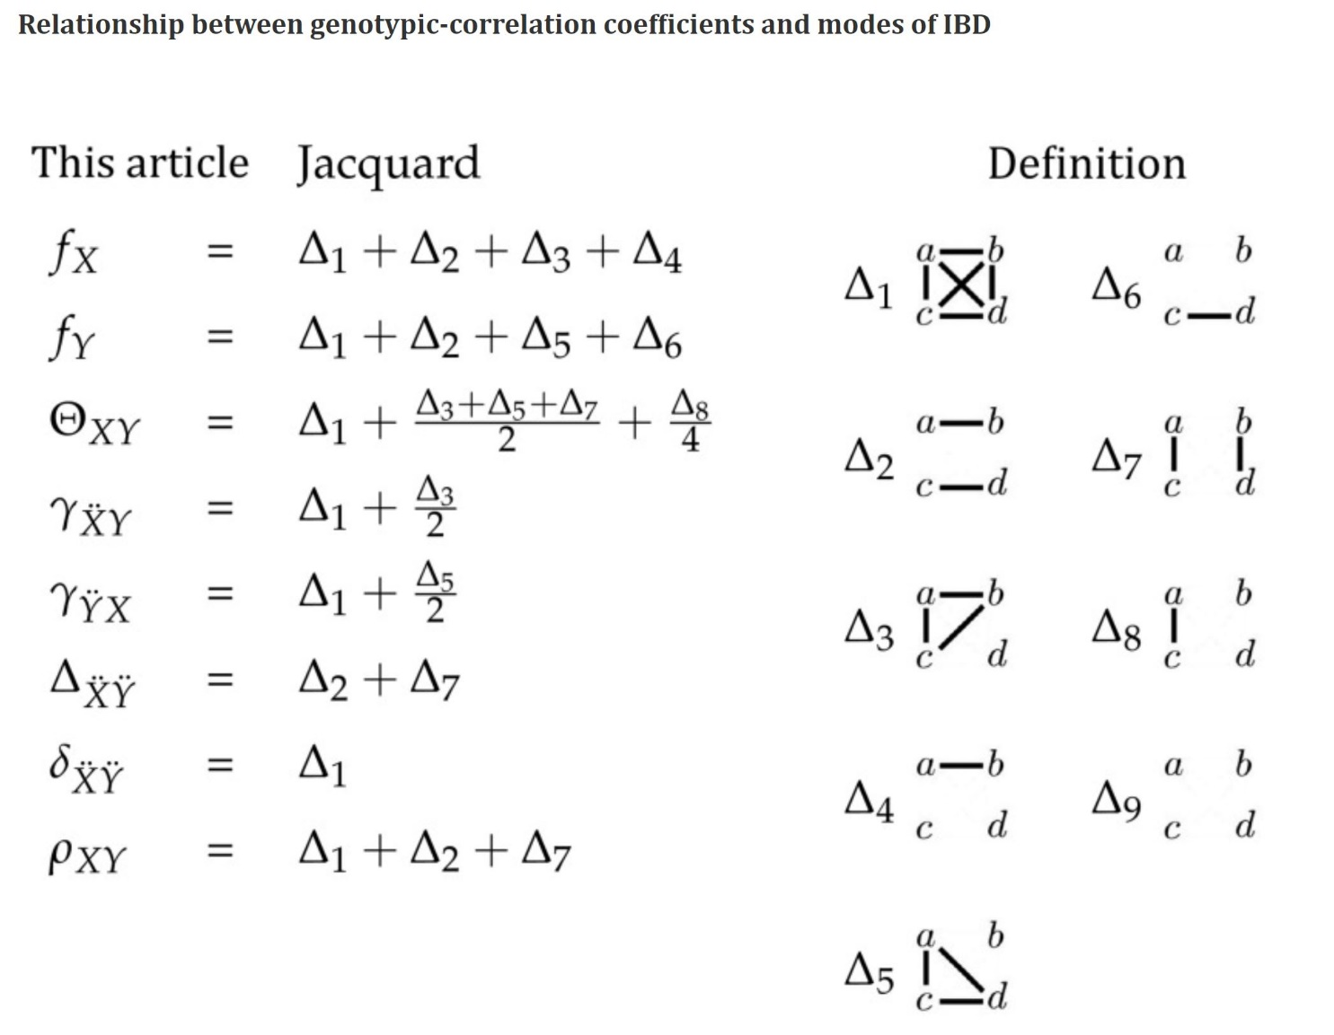
Ackerman, others, Lynch, 2017. Coefficients of pairwise relatedness.
Enjoy, no need to learn anything here.
As you can guess from the table, even simple considerations such as homozygous vs. not-homozygous and related parameters can be complex. This here is beyond what we need. Yet. There is more than enough for you to learn and study if you feel inclined to do so.
At least you see that the relationship between the two gametes that make one genotype (make it heterozygous or homozygous, and if homozygous then ais or ibd) … this relationship can exist in a way even between two gametes which did not jointly make a genotype but which, for instance, were two pollengrains and fertilized two different egg-cell, and ... so … on.
10.1534/genetics.116.190660
4

Slide 5
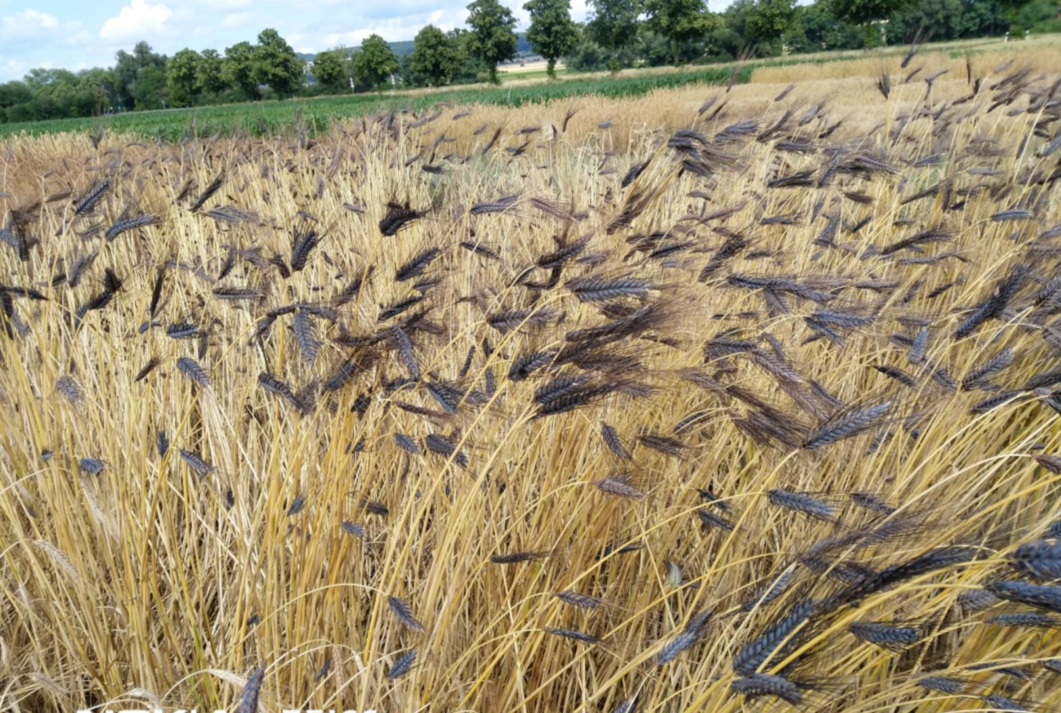
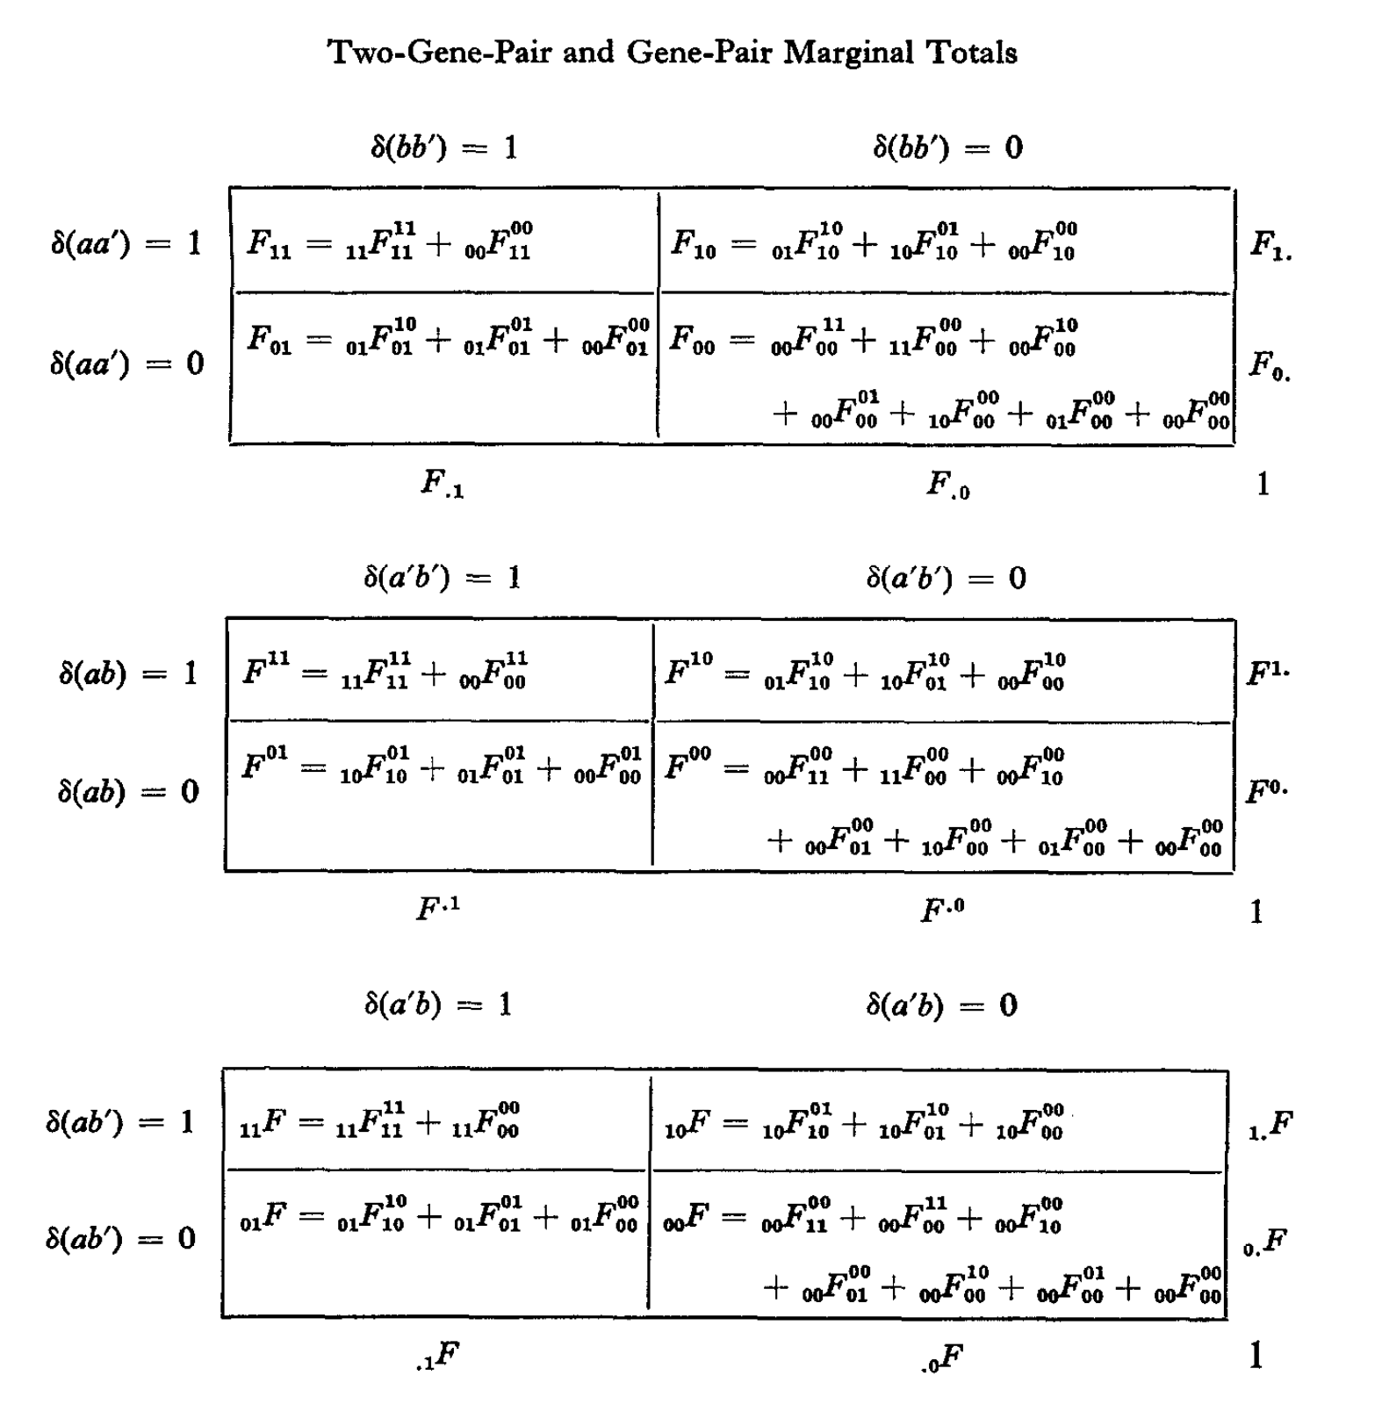
Descent Measures for Two Loci with some Applications.
Enjoy, no need to lean anything here.
Foto: © WL; Emmer, Triticum dicoccon, ‘Ramses’.
Cockerham, Weir, Theoretical Population Biology 1973
https://doi.org/10.1016/0040-5809(73)90013-0
5

Slide 6
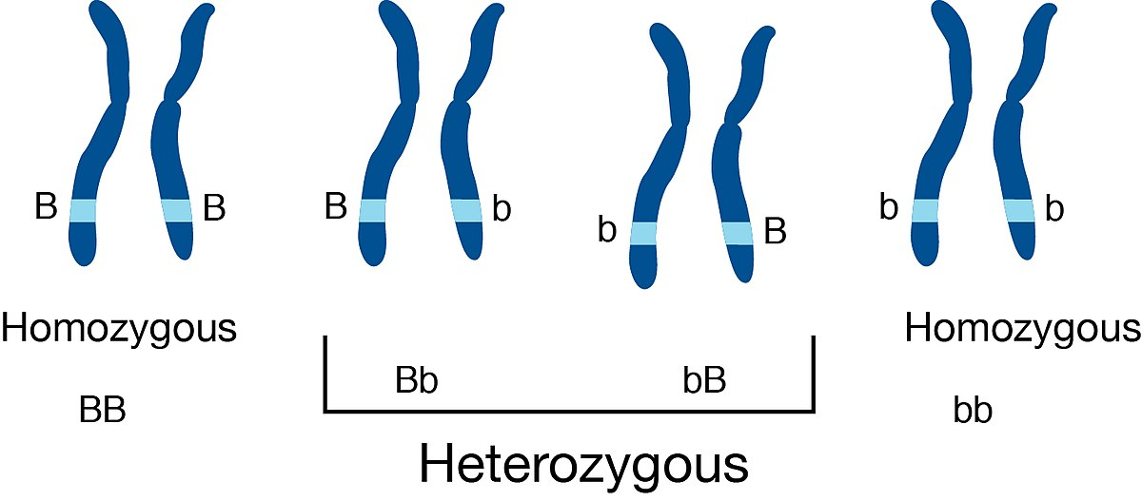
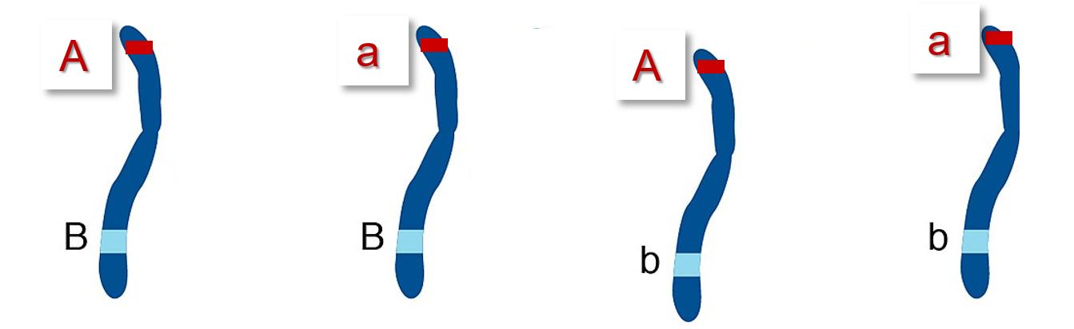
Homozygous vs. Heterozygous, focus on one locus and it alleles (same or not same)
Coupling phase vs. Repulsion phase (focus on two loci and ... ‘who with whom’?)
6
If needed, visit again UNPLAB-PopGen_Ch-10[LD II]
The two loci, A and B, need not be located on the same chromosome! Two loci may show LD≠0 even if located at large cM-distance on same chromosome or even on separate chromosomes (means 50% recombi-nation frequency).
Haplotypes (‘Gameto-types’ ;-)
AB aB Ab ab
Coupling Repulsion Coupling
Phases

Slide 7
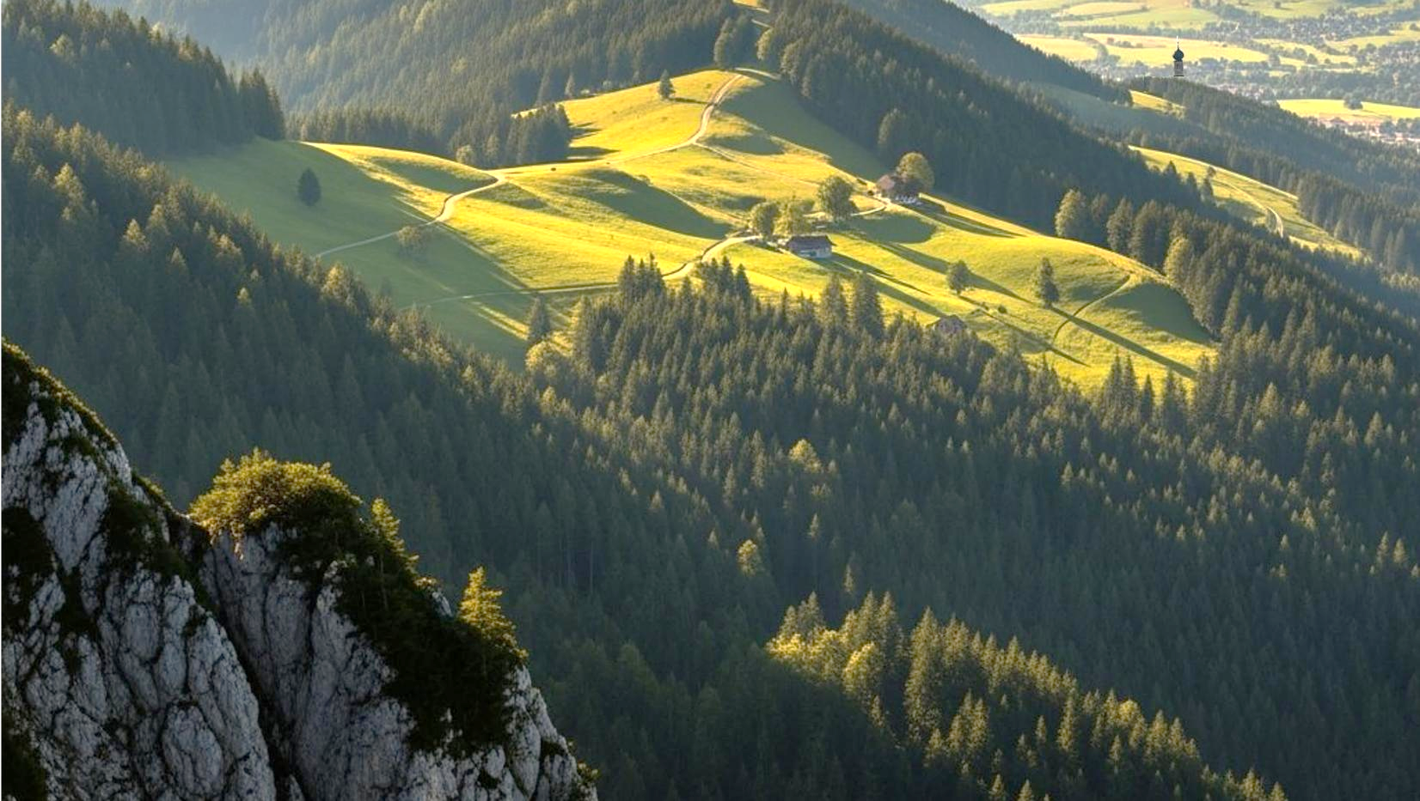
What is a marker? I mean, a genetic marker?
A perfect marker for marker-assisted selection produces no false positive results. It shows directly the focal, responsible point mutation or INDEL mutation or the like.
In Bavaria (a federal state of Germany, in our South-East), very often when looking from the mountain hiking trail, you may see the bell tower of a church from a far distance.
You can barely see or tell the individual houses, yet, the tower of a church you may see.
7

Slide 8


„A genetic marker is an allelic variation an a specific locus that can be reliably scored“.
„Two alleles at a monogenic locus such as flower colour; or two alleles or an SNP, A versus T or the like, and reliably scored via KASP technology or the like. Whether you need to know the site of the marker locus on a map depends on the intended application of the marker. Whether you need the marker to be association with some other locus depends on the intended application of the marker“. Cited from my former colleague Wolfgang Ecke, Göttingen, 2017.
Allegory coined by Gerd Wenzel, former Prof. TUM Munich (Bavaria).
In Bavaria (Bayern), very often when looking from the mountain hiking trail, you may see the bell tower of a church from a far distance – and again very often, in the directly neighboured to the church, there is a pub. You would not see the pub – pubs have no tower. So ...
The church is a marker (landscape marker) for the pub – and it is the pub where you get your beer*, of course.
*zero-alc beer, very probably
8

Slide 9
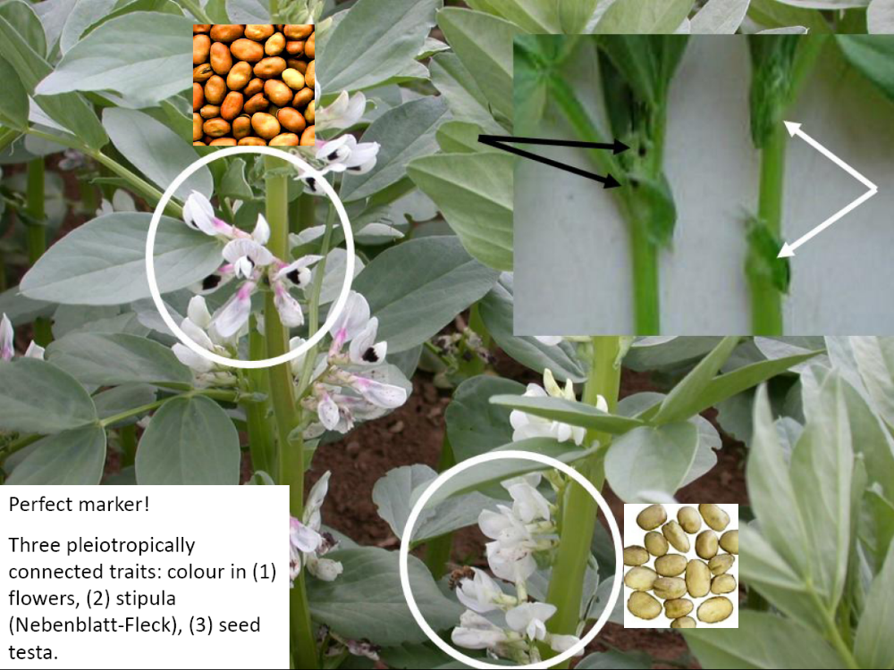
© WL
Pleiotropy refers to a gene influ-encing several, seemingly unre-lated traits (here: flower pigmen-tation; stipule spot pigmentation; seed testa pigmentation indi-cating seed testa tannin con-tent). One gene’s impact isn't limited to just one trait but ex-tends to several traits.
Pleiotropy makes a perfect marker, such as “pure white” in flowers is always accompanied with “no colour at stipule” and “zero tannin in seed coat”.
But even in then, as in this case, new genotypes may change the picture and the perfection of the scene, see:
DOI: 10.1017/S1479262118000205
DOI: 10.1021/acs.jafc.9b07
9
A perfect morphological marker! Three pleiotropi-cally connected traits: Colour in (1) flowers,
(2) Stipule spot (Neben-blatt-Fleck),
(3) Seed testa colour and tannin content.

Slide 10
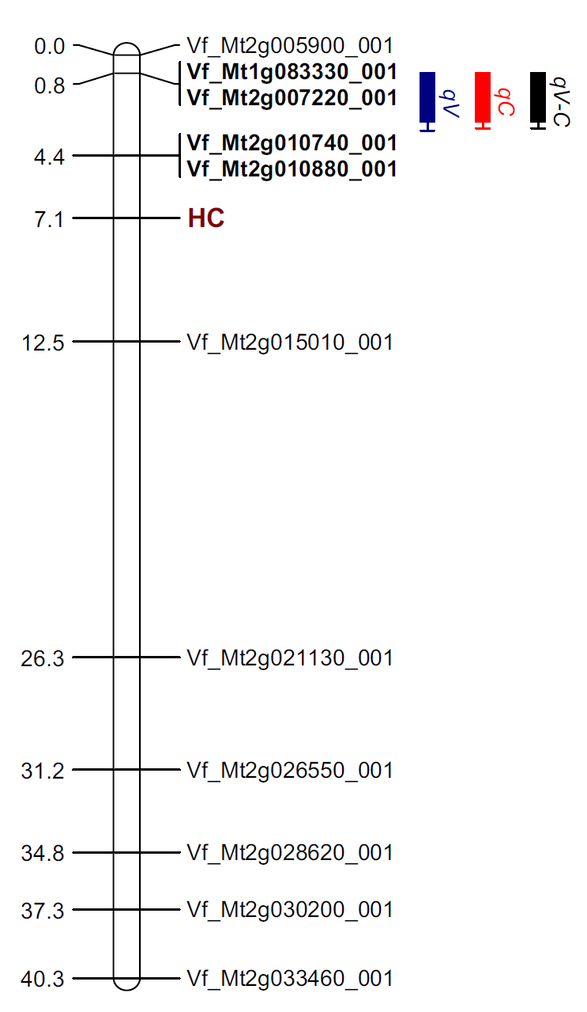
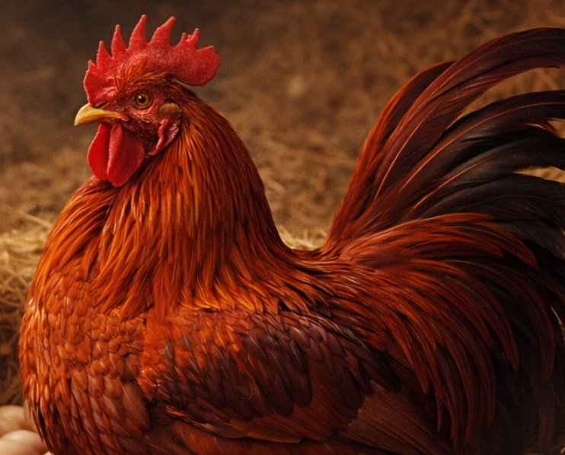
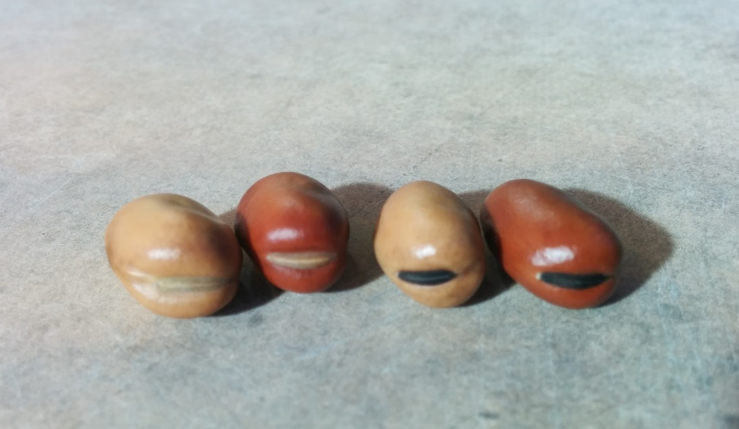
The association between a major QTL for Vicine-Convicine content in Vicia faba (an antinutritive compound) and hilum colour makes hilum colour „white vs. black“ a useful morphological marker (no pleiotropy here but linkage).
White
Black
Vicine-convicine content, major QTL explains >70% of trait variation. Coloured bar indicates approx. chro-mosomal location. (DOI:10.1007/s11032-015-0214-8).
Heterozygosity for this Vicine-QTL causes intermediate Vicine content.
Hilum colour locus, monogenic trait, black is dominant over white.
© WL
Linked loci. Loci located at tip of first chromo-some of Vicia faba, recombination frequency ~5-10% (~5-10cM mapping distance), deduced from studies in several crosses (ZVC-1268 x KK13; ZVC-1268 x BPL263; ZVC-1268 x 29H;Ramsay, 1995; Khazaei et al., 2015).
Sketch. ‚Tip‘ of chromo-some 1 of Vicia faba; scale in centiMorgan.
10

Slide 11
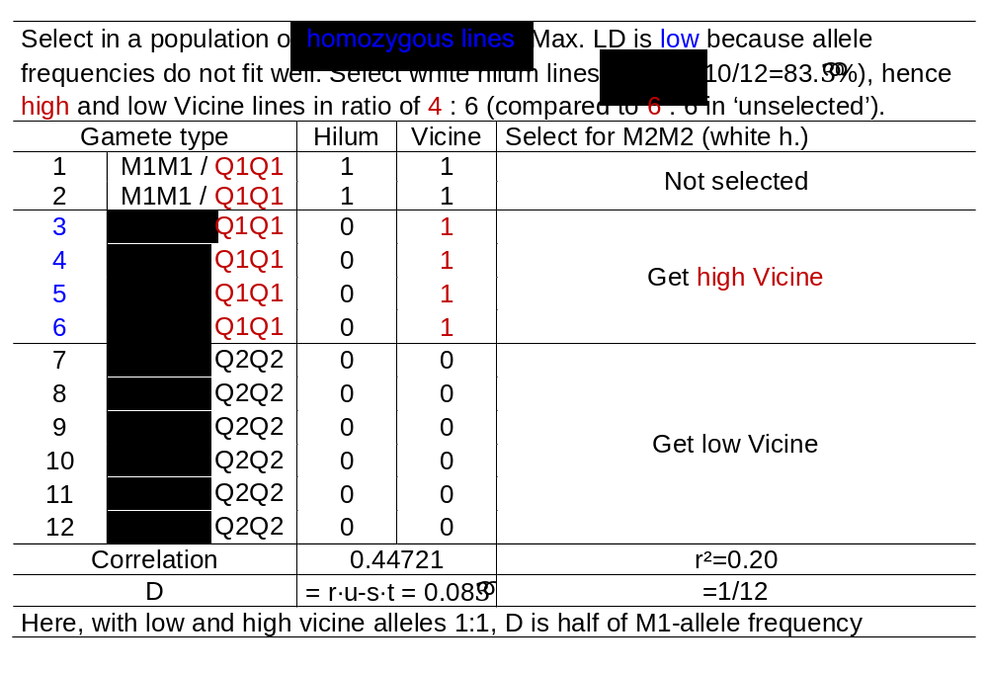
If allele frequencies at Marker locus and QLT do not fit well, then maximum possible LD is low (and, anyway, there is no guarantee that actual LD is at its maximum).
White hilum colour M2 is reces-sive versus black hilum colour M1. Here, all genotypes are homozy-gous, so recessive-dominant is no topic. Yet, if heterozygous geno-types occur, then having white hilum in phase with the desired low Vicine content (M2-Q2; our case here) may be more favour-rable than having black hilum in phase with low Vicin2 (M1-Q2). Some of the phenotypically black hilum genotypes may – then –be only heterozygously black. The consequence would be that often selected black-hilum types are not homozygously low Vicine (Q2Q2) but only Q1Q2.
11

Slide 12
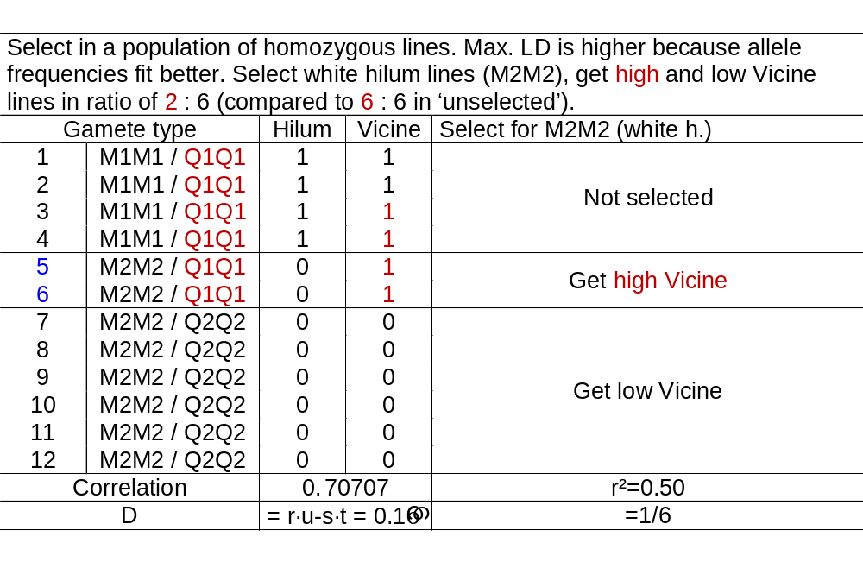
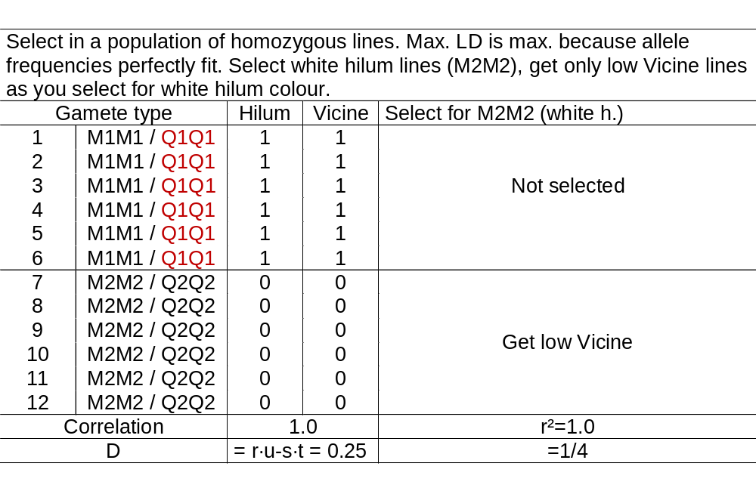
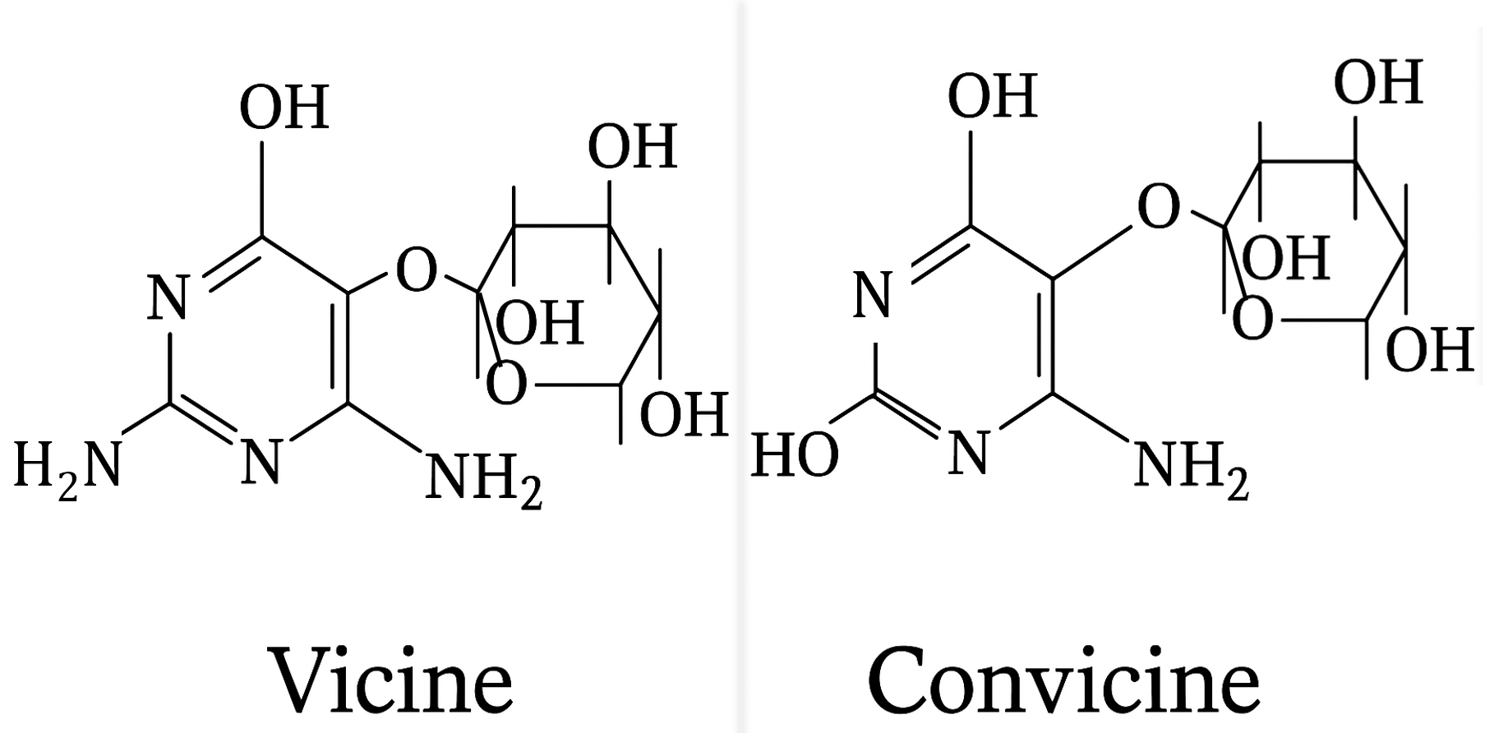
LD is higher here, with M1 allele frequency at 1/3 and 1/2; this allows a higher max. LD.
Left table: LD is higher than before (1/6 < 1/12), be-cause allele frequencies fit better now. Result: Higher dose of correct genotypes (Q2Q2) than before (75% rather than 60%). For comparison, a random sample has 50% correct genotypes .
Right table: LD is perfect, D=0.25, allele frequencies fit. All selected M2M2 now would be Q2Q2.
12

Slide 13
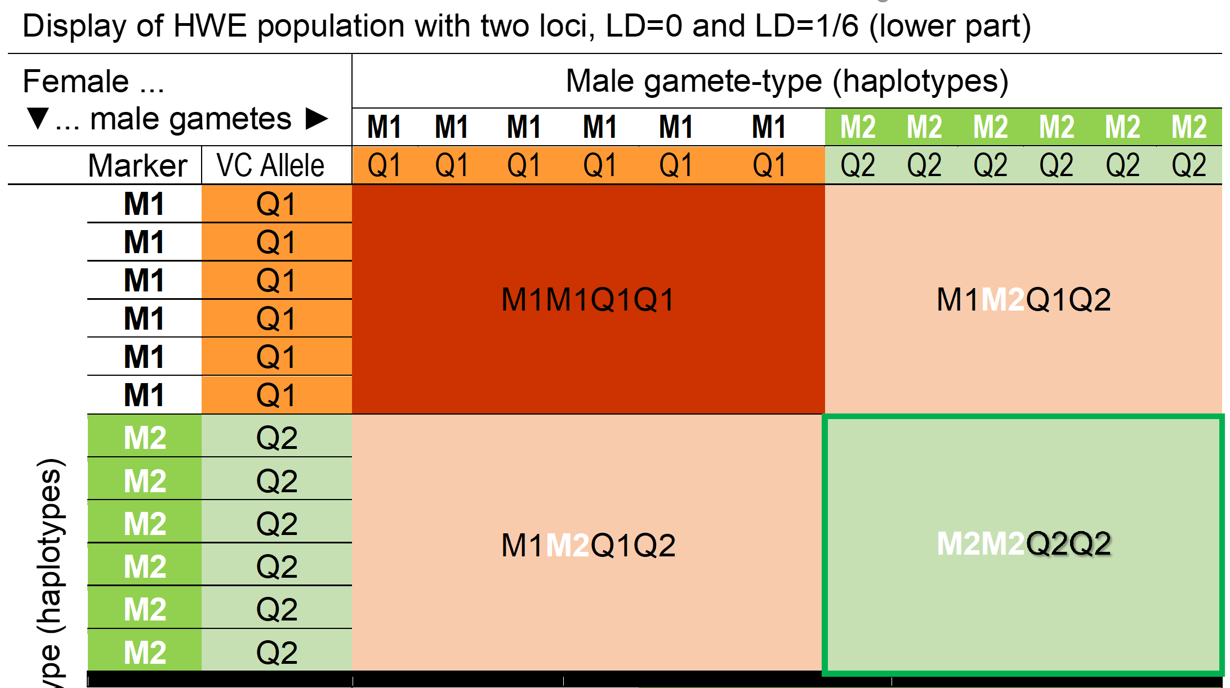
Here, the genotypes are not all homozygous. We create from ‘LD=0.25 gametes’ a HWE population . You see the p²+2pq+q² at both loci (max. association).
13
(i.e., the correlation between the 2 loci is r=1.0)
Select for white hi-lum phenotype! You select the M2M2 homozygotes. These are then all Q2Q2, this means they are all homozygous for Low Vicine and thus with Low Vicine phe-notype. This selec-tion is, hence, ‘per-fect’; fully efficient.
You take 25% of the population, all of them are as desired.
p²
pq
Female gamete-types (haplotypes)
pq
q²

Slide 14
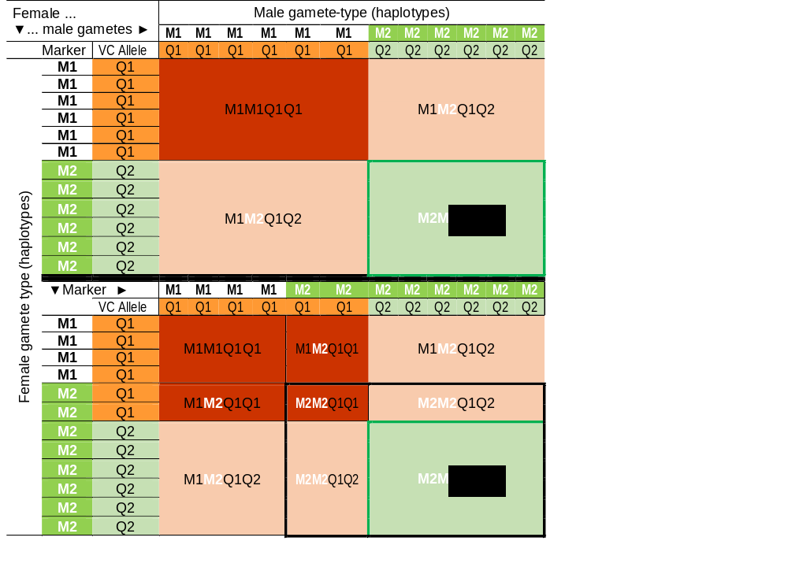
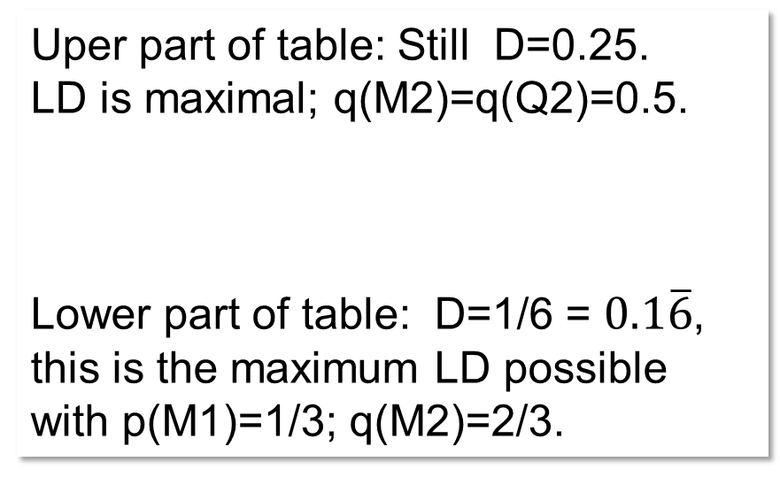
Uper part of table: Still D=0.25.
LD is maximal; q(M2)=q(Q2)=0.5.
Lower part of table: D=1/6 = $0.1\overline{6}$, this is the maximum LD possible with p(M1)=1/3; q(M2)=2/3.
Lower part of table: Select for white hilum pheno-type means that you select for M2M2 homozy-gotes. You take 64/144=4/9 of the population and 36/144=1/4 of the population, the desired Q2Q2, are all included. 36/64 of the hilum-based selec-ted ones are correct (56.25%). To compare, if you chose at random, then only 25% would be correct, since this is the ‚anyway‘-proportion of Q2Q2 in the population.
The lower the LD is, the less precise and efficient is your Marker-Assisted Selection.
14

Slide 15
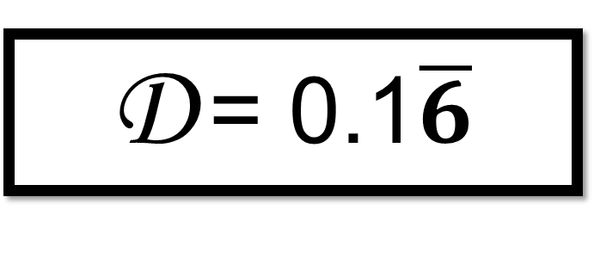
decay
Once again, to really ‘hammer this home’: LD decay! If e.g. initially most gametes (coupling phase) are M1Q1 and M2Q2, few are M2Q1 and none were M1Q2 (e.g. LD=1/6) … then: Such setting will change ‚by-genera-tions-of-random-mating-reproduction‘ (due to meiotic recombination). The majority class of coupling phase double heterozygotes should not only produce gametes (M1Q1 and M2Q2) but as well repulsion phase gametes (M2Q1, M1Q2) – this will indeed occur, if the 2 loci are not fully linked (if linkage is not fully protecting LD from decay). Generation by generation of random mating, we will see the association to decay towards D =0; the alleles Q1 and Q2 will then occur with M1 or M2 at random frequencies.
decay
15
D = 0.1$\overline{6}$
Decay
D = 0.0
M1Q1 M2Q1 M2Q2
M1Q1 M1Q2 M2Q1 M2Q2

Slide 16
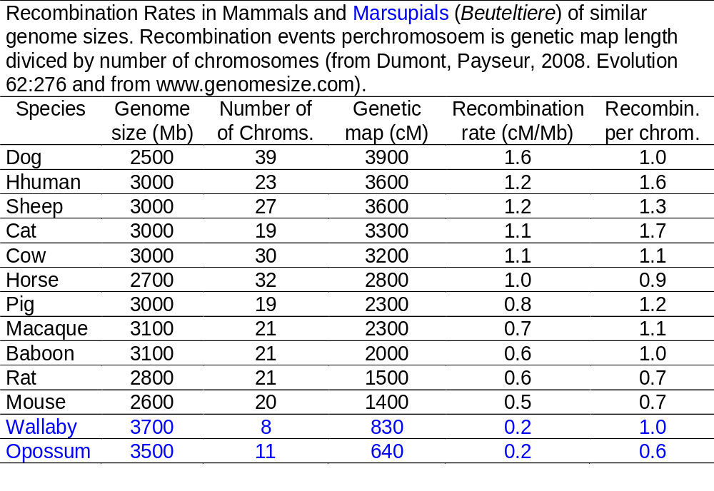
LD decay depends: Is there LD at all? If so, will it and how will it decay from this to next generation (decay via meiotic recombination). Hence, recombination rate counts.
We find in most of these animal species a recombination rate of 1.0 or slightly more or slightly less.
In our usual crop plants, the per-tinent literature reports on 1-3 re-combinations per chromosome. It is about 1.1 recombinations per chro-mosome in Arabidopsis, about 1.2 in Brasica napus, about 1.6 in wheat, about 2.2 in faba bean, and about 2.8 in soy
In maize, we see about 23 chromo-somal segments that undergo ‚un-broken‘ through one meiosis, and this is with its 10 pairs of homolo-gous chromosomes, so it is about 1.15 breaks per chromosome per meiosis.
Very roughly: One or two breaks per chromosome per meiosis.
16

Slide 17
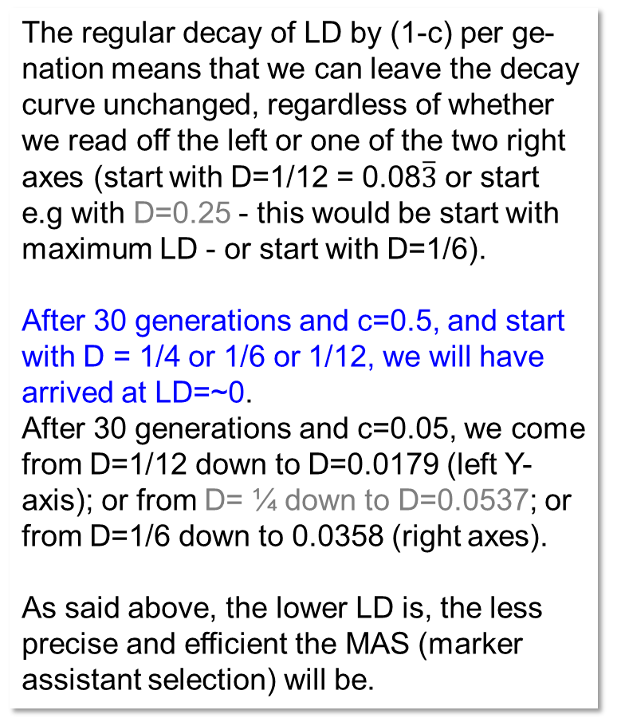


Decay of initial gamete phase disequilibrium across 30 generations of random mating without linkage (c=0.5) vs. with high linkage (c=0.05).
The regular decay of LD by (1-c) per ge- nation means that we can leave the decay curve unchanged, regardless of whether we read off the left or one of the two right axes (start with D=1/12 = 0.08$\overline{3}$ or start e.g with D=0.25 - this would be start with maximum LD - or start with D=1/6).
After 30 generations and c=0.5, and start with D = 1/4 or 1/6 or 1/12, we will have arrived at LD=~0.
After 30 generations and c=0.05, we come from D=1/12 down to D=0.0179 (left Y- axis); or from D= ¼ down to D=0.0537; or from D=1/6 down to 0.0358 (right axes).
As said above, the lower LD is, the less precise and efficient the MAS (marker assistant selection) will be.
0.08$\overline{3}$
0.25
0.1$\overline{6}$
0.08
p=q=0.5; v=1/6, w=5/6; c=0.05 strong linkage
0.16
D
D
p=q=0.5; v=1/6, w=5/6; c=0.50 zero linkage
D(t) = (1-c)D(t-1)
D(t) = (1-c)^{t}D(t=0)
0.20
0.06
0.12
0.15
Extent of gamete phase disequilibrium
0.08
0.04
0.10
0.02
0.04
0.05
0.00
0.00
0.00
0
5
10
15
20
25
30
Generations of random mating
Show your ambition and draw a line yourself, based on the decay of the LD, and your line and shows then
the loss of efficiency of the MAS (e.g. expressed as share Q2Q2 after selection on M2M2).
17

Slide 18
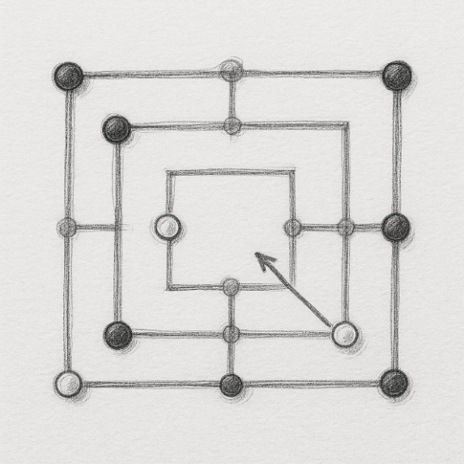
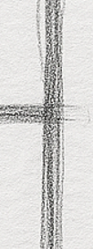
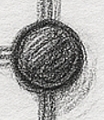



Nine Men's Morris (Mühlespiel). You see: With your next move, you can complete a ‘mill’ and take a stone from your fellow player.
As in this board game,
where you can close
a ‘mill’ only once , in
MAS you can exploit
the LD between marker
and focal locus only
once. After you have e.g. selected all M2M2 and gained as much Q2Q2 as the current LD allows, after that ‘move’, the marker locus is monomorphic, no more M1 is available, and you can no longer employ this marker locus for MAS. My diagrams for LD-decay hide this somehow. The lines should stop at that very generation where you decide to use the LD between marker and trait locus four your MAS. Well: If you select on the basis of many markers simultaneously, then you probably won’t find candidates which are correct for all markers … so you can use the not-yet mono-morphic ones in the next generation ;-).
0.25
D
95% of 0.250=0.2375
p=q=0.5; v=w=0.5; c=0.05
p=q=0.5; v=w=0.5; c=0.50
0.20
0.15
Extent of gamete phase disequilibrium
0.10
D(t) = (1-c)D(t-1)
D(t) = (1-c)^{t}D(t=0)
0.05
0.00
0
10
20
30
40
50
60
70
80
90
100
18
Generations of random mating

Slide 19
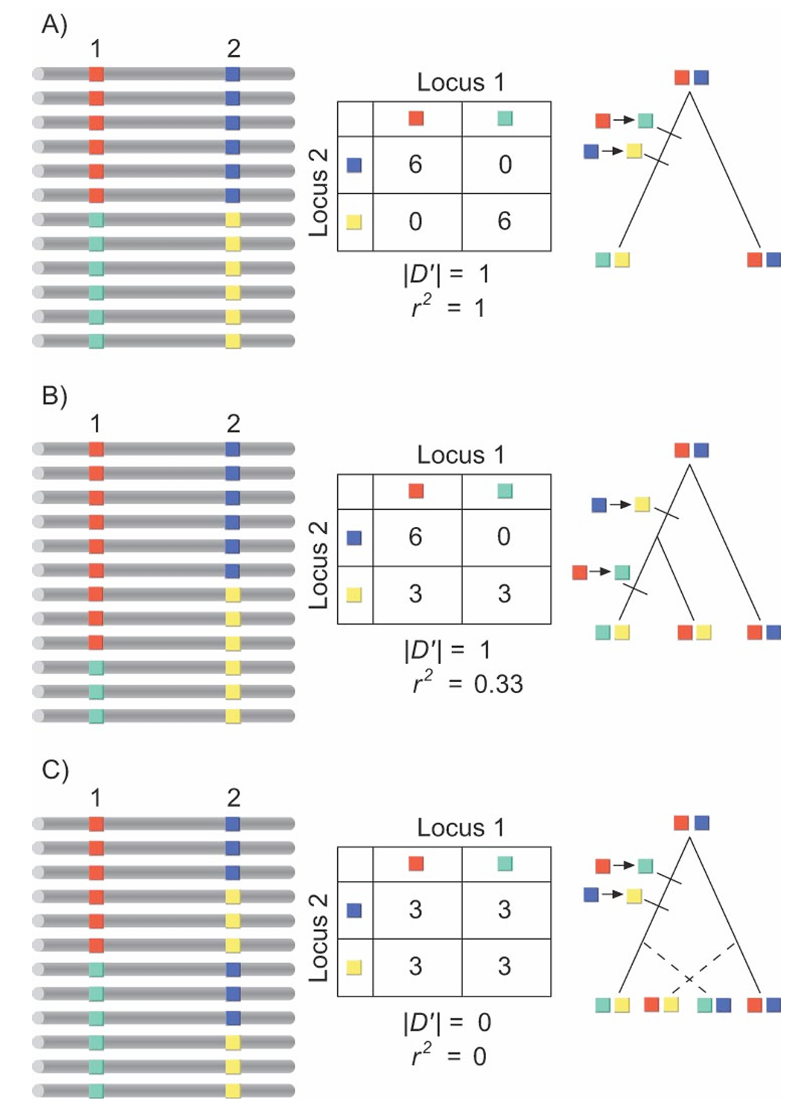
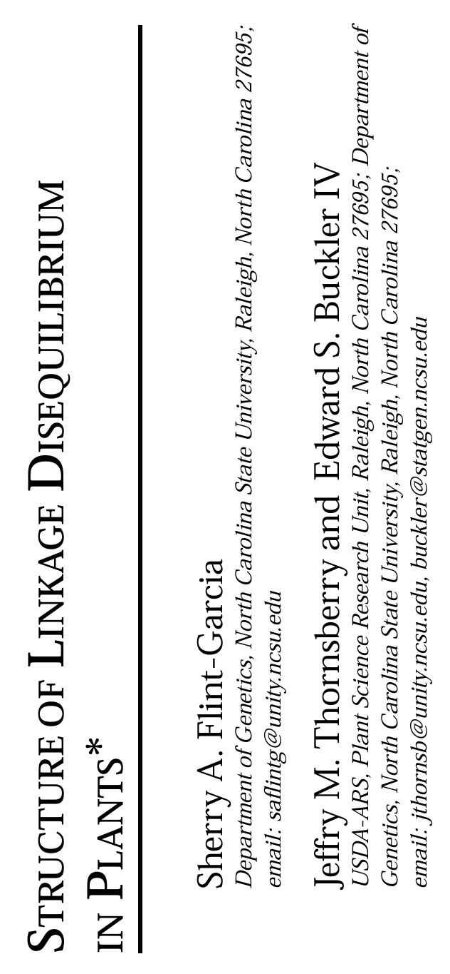
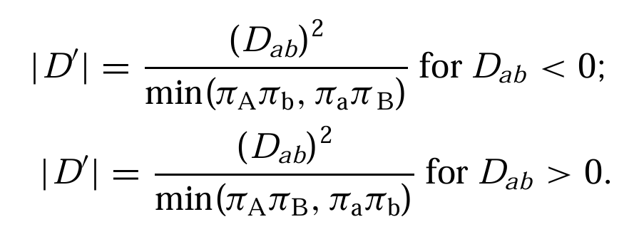
Realise your ambition! Study publications on LD and applied crop genetics yourself, without my help; such as this paper (DOI 10.1146/annurev.arplant.54.031902.134907; from Flint-Garcia, Thornsberry, Buckler IV).
19
Scenarios of LD between linked loci; polymorphisms caused by different mutational and recombinational histories de-monstrating the behavior of the r² and D’ statistics of LD. Images in the left column represent the allelic states of two loci. The middle column represents the 2 x 2 contingency table of haplotypes and the resulting r² and D’ statistics. The right column represents a possible tree responsible for the observed LD present.
Absolute LD exists when two loci share a similar mu-tational history with no recombination. Both r² and D’ equal 1.
LD can result when mutations occur on different lineages without recombination between the loci. Notice the large difference in measures of LD as calculated by r² and D.
Linkage equilibrium is produced when there is recombination between loci, regardless of mutational history. In this situation, both r²and D’ equal 0.

Slide 20
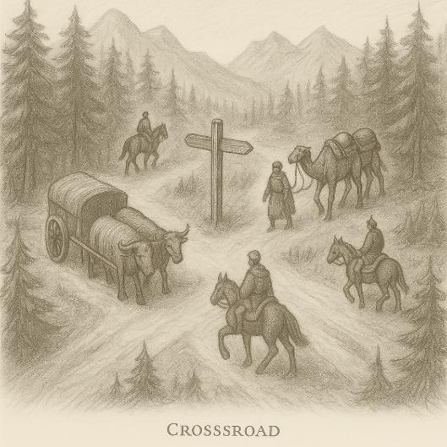
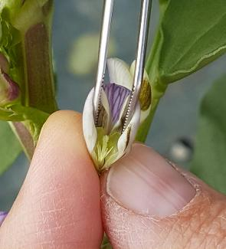
We are going to talk about a ‚cross‘. So, what is this: A Cross. See left picture. The Roman Empire relied on long-distance trade routes connecting places such as Mogontiacum (Mainz) and Augusta Raurica (near Basel). Near modern-day Ettlingen (Ediningom), an important long-distance cross-road was built and carefully maintained, linking the West areas with the East across the river Alb and the North-South junction along river Rhine. The routes were vital for all military and civil goods (Wells, 1995, The Roman Empire, 2nd ed., Harvard UP).
You may as well think about a Cross in Plant Breeding terms as the actual carrying out of the crossing activity. Breeders may term the crossed seed in a paper bag „cross“; or the plants growing from such hybrid seed, the actual F1-plants, are often-times and gladly called „cross“. Even a bulk or the sum of all SSD lines from a cross may be called „cross“. Watch out for context to always get it right if you hear about a cross.
© RM
We are now talking about the self-fertilized offspring from a cross of two homozygous parents, and we have a look how it causes LD (lin-kage disequilibrium = gamete phase disequilibrium) for all loci that are linked and heterozygous in the F1 generation. So: It is about a Mendelian F1, and about its F2, and F3, and more …
A cross; cross-road.
20

Slide 21
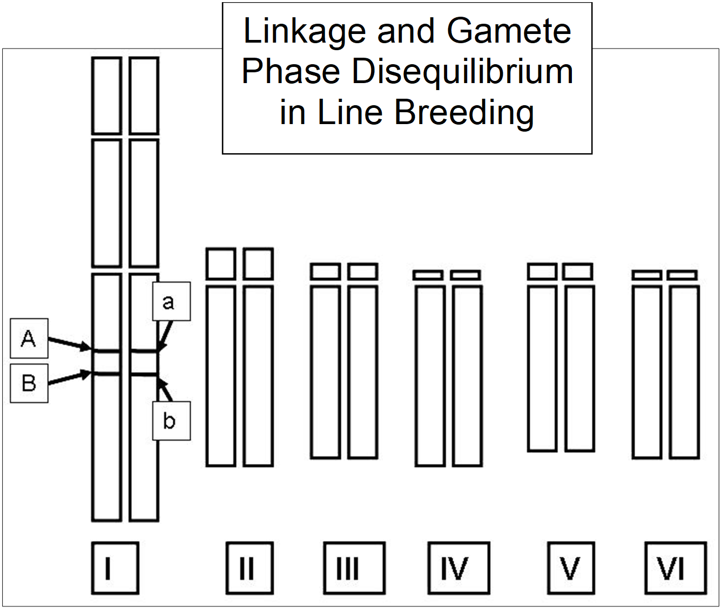
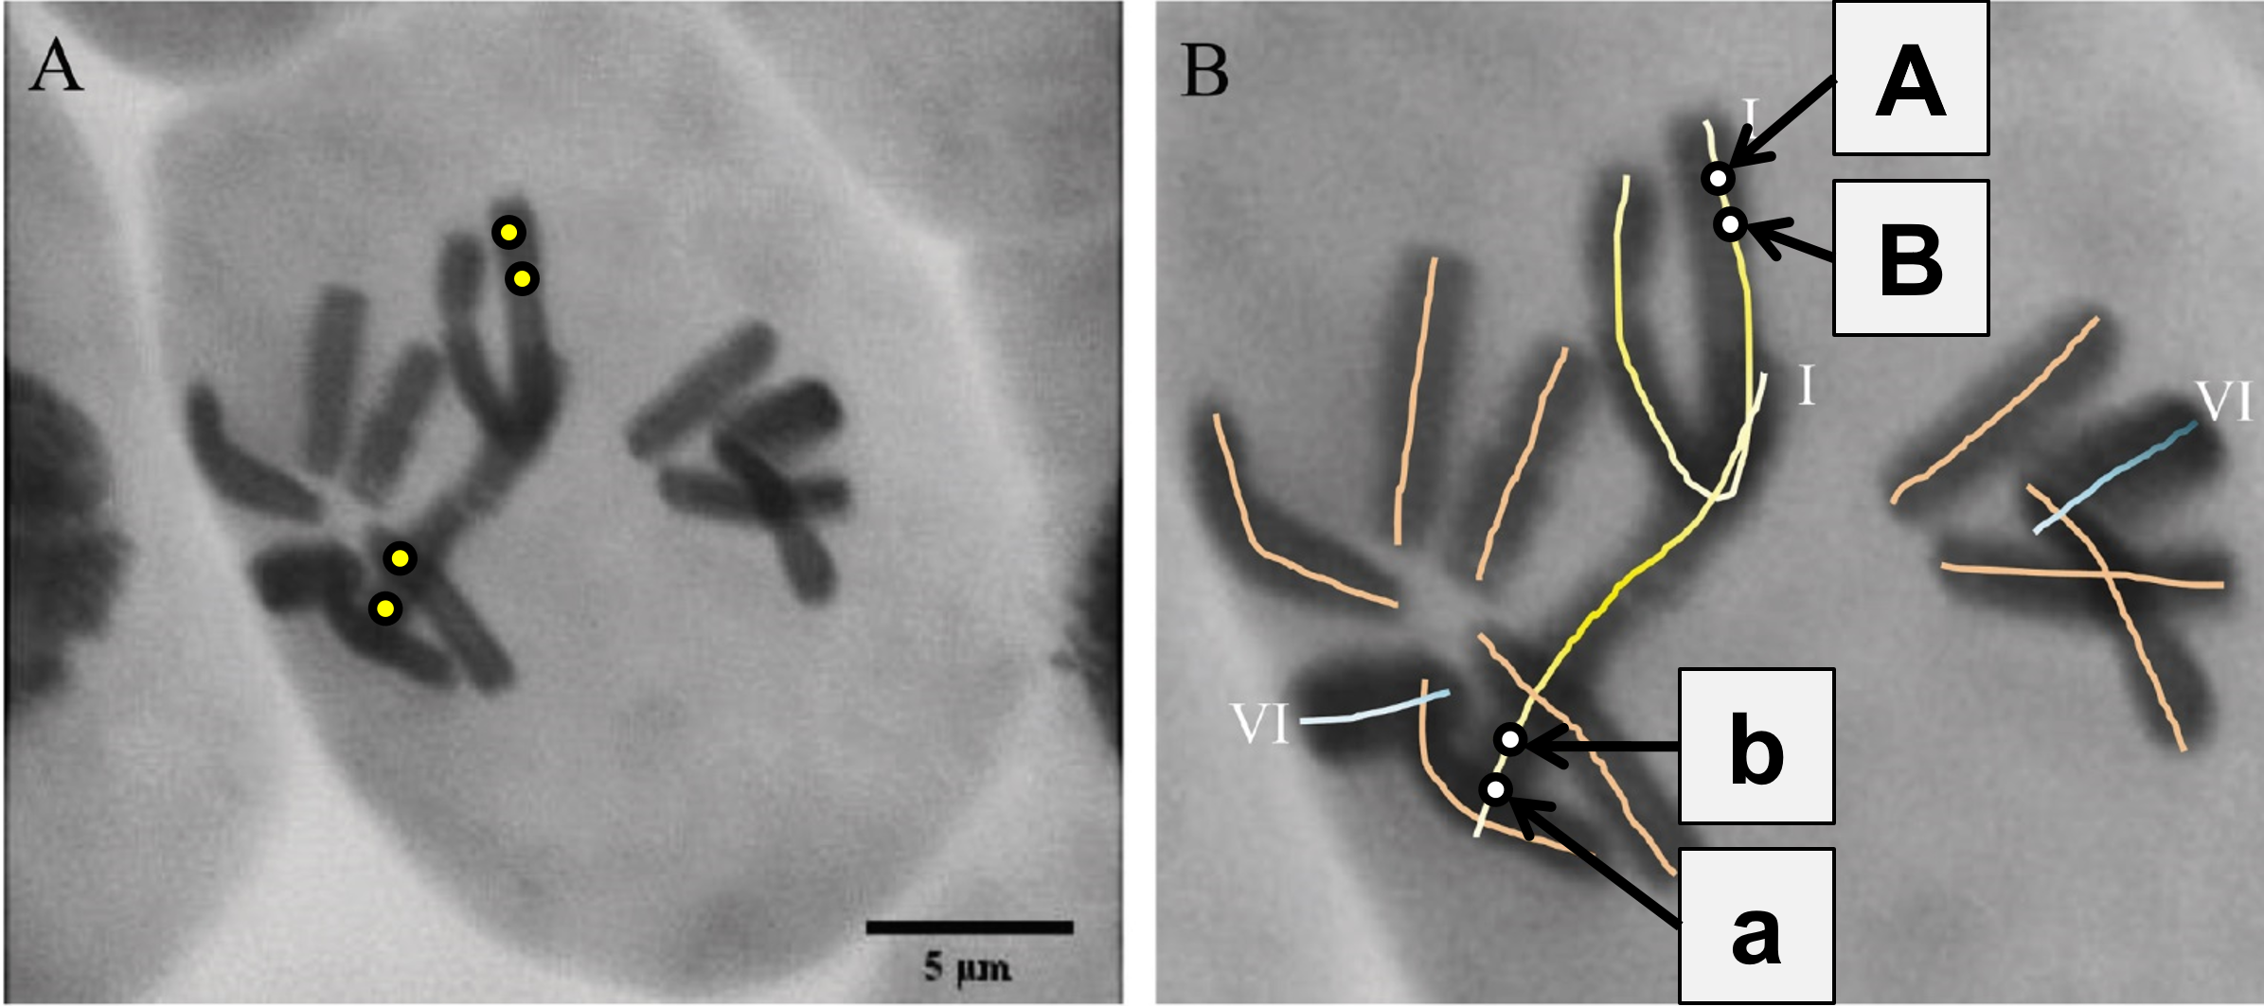
We start with a double heterozygous coupling phase genotype (AB/ab). Notice well that we abandoned Random Mating and are in the frame of Line Breeding.
Which gametes (haplotypes) have mated to produce this genotype? Of course gamete-types (haplotypes) ‚AB‘ and ‚ab‘. Can we contemplate their LD? It is as if these two are the total pool. D=1/4, of course, because all B go with A, all b go with a. Which gamete types (haplotypes) will be produced by this hybrid genotypes? In which frequencies?
The possible haplotypes (gametes) coming from the F1 are ‘AB‘, ‘Ab‘, ‘aB’, ‘ab’. If no linkage (c=0.5), then these four types will be produced by the F1 genotype in same frequencies.
Inspired by Schubert et al., 997, Cell 88, 515–520.
Vicia faba chromosomes in Metaphase, Feulgen staining.
21
DOI 10.1093/jxb/erx117

Slide 22
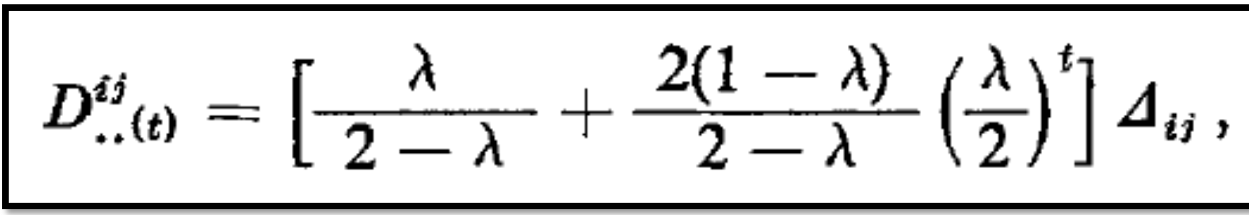
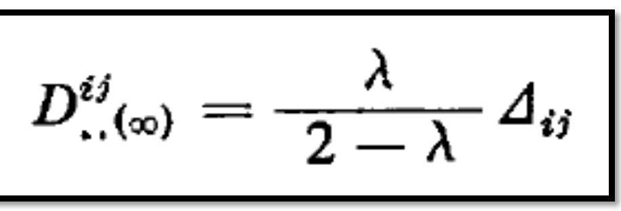
A first eminent insight: All what is in LD=max. in the two gametes that made our F1 will be at LD=0 in the next generation: If there is no linkage! We can see a decay of LD from maximum down to zero in one step, a thing we never see in case of random mating.
THEORETICAL POPULATION BIOLOGY 4, 300-330 (1973)
Descent Measured for Two Loci with Some Applications
C. Clark Cockerham (North Carolina State University, USA) and
B.S. Weir (Massey University New Zealand).
The Algebra given in this paper, shown below (it took me quite a while to find such equation), allowed to draw the here-following diagrams.
The parameter λ means ‚linkage‘ in the following sense:
No linkage ► λ =0.0 (equivalent to c=0.5)
Full linkage ► λ =1.0 (equivalent to c=0.0)
λ=1-2c
22

Slide 23
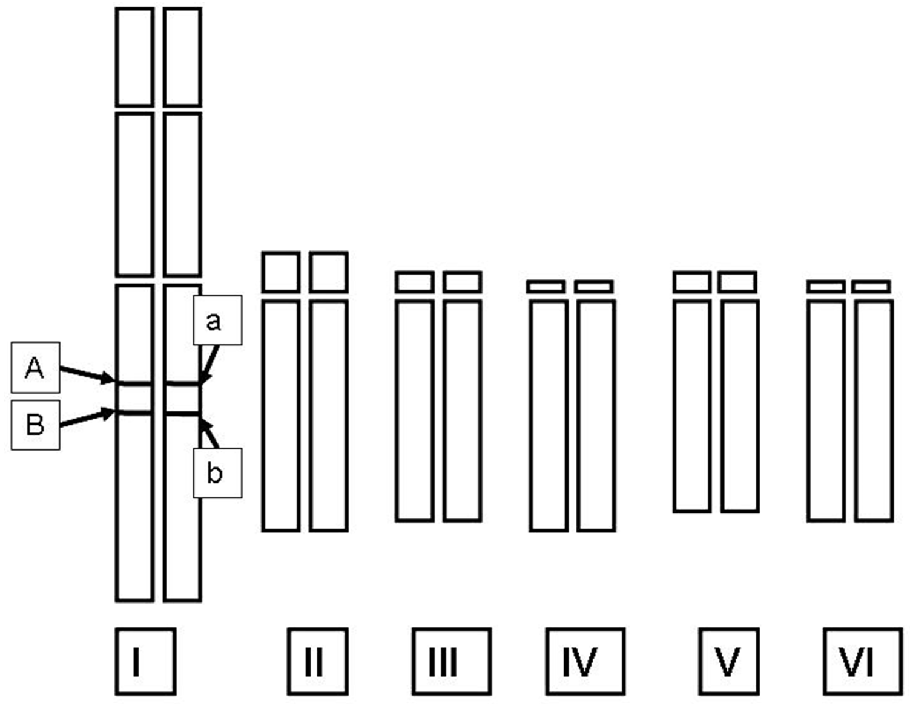
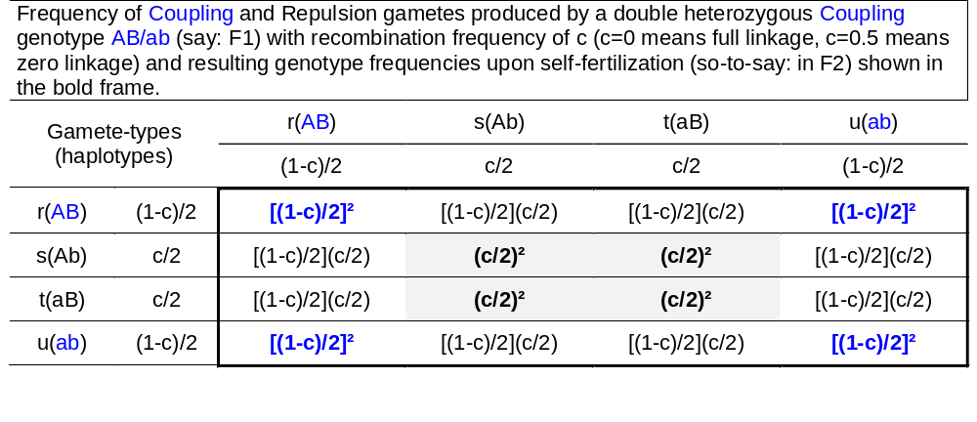
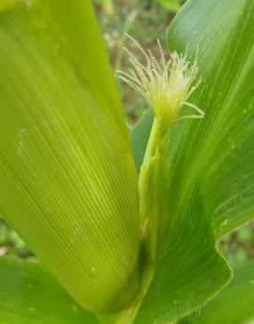
LD of the gametes that produce a Mendelian F2-generation (by selfing an F1).
D=ru-st = [(1-c)/2]² - (c/2)² = ¼[(1-c)² - c²] = ¼[(1-2c +c² - c²] => D = ¼ (1-2c).
With c=0.05, D=0.225; with c=0.1, D=0.20.
23
Mind, the LD of genotypes (generation, population) is the LD of the gametes which produced these genotypes. Here: The initial D=0.25 in the gametes that produced the F1 is reduced – for instance - with c=0.05 to D=0.225 or with c=0.10 to D=0.20 in the gametes coming from such F1 and (via selfing) producing F2. With c=0.5, the initial D=0.25 would be reduced to 0.
Again: All pairs of unlinked loci will be in gamete phase equilibrium (D=0) in the gametes that come from an F1 (whether they then undergo selfing or crossing doesn’t change this).
Maize at ‚silking‘.
© WL. Gametes are pro-duced in flowers.

Slide 24
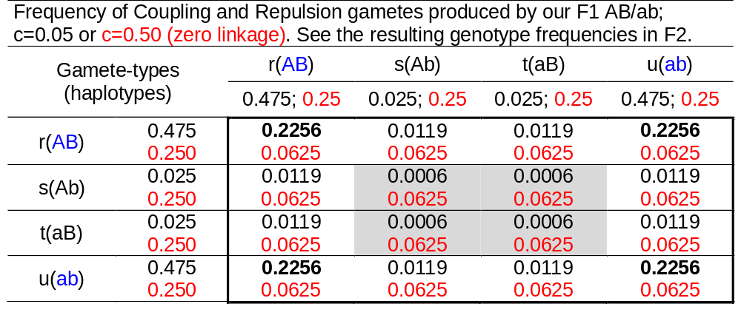
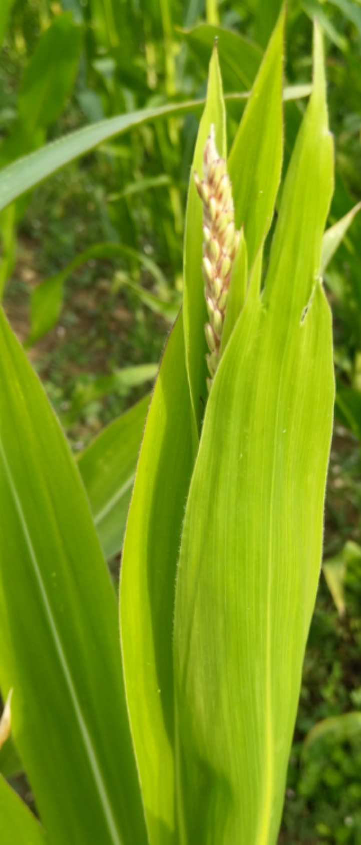
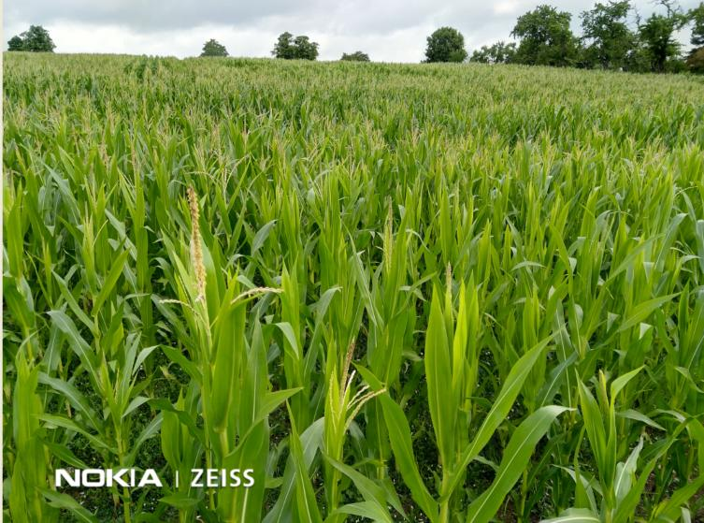
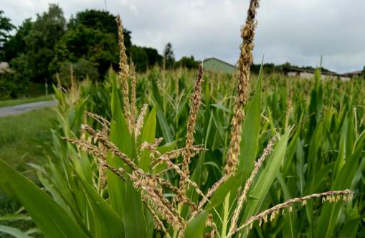
Numerical example
© W. Link Gametes are produced in flowers. Here: Anthesis, male flowering in maize.
24

Slide 25

Numerical example
25
With nearly full linkage (c=0.05, i.e. only 5% recombination rate instead of 50% which would be free recombination) we see that F2-individuals created by the mating of two coupling gametes are by far (90.25%) the majority of in F2; whereas with c=0.5, all combinations of coupling and repulsion have equal frequencies.
What is the Disequilibrium in the gametes that produce this F2?
c=0.05 ► D = ru-st = 0.225 equivalent to D = ¼ (1-2c) = 0.225
c=0.50 ► D = 0

Slide 26
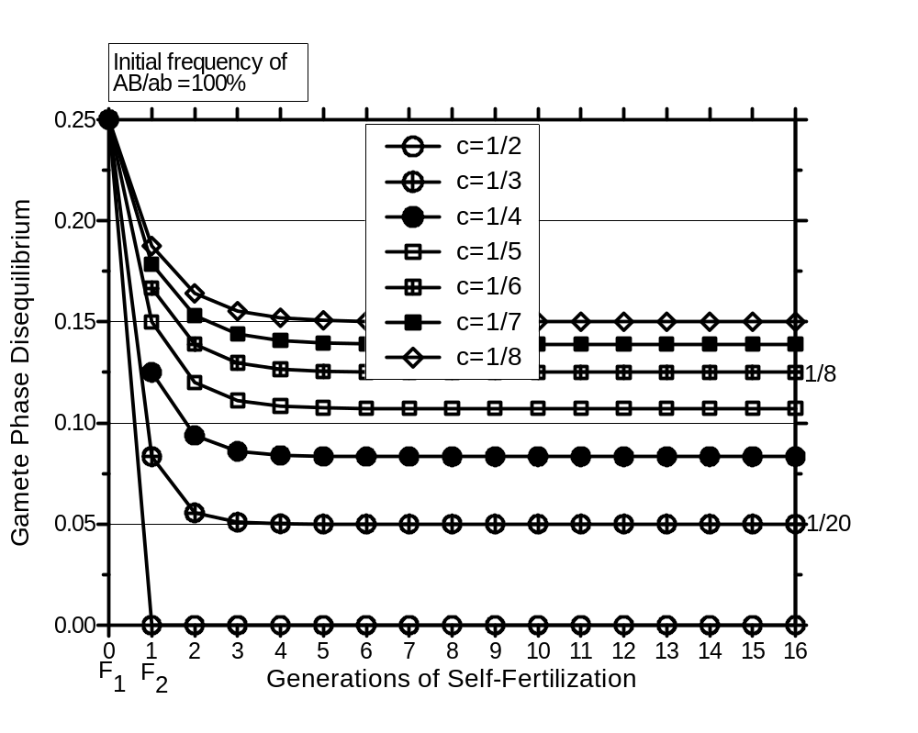
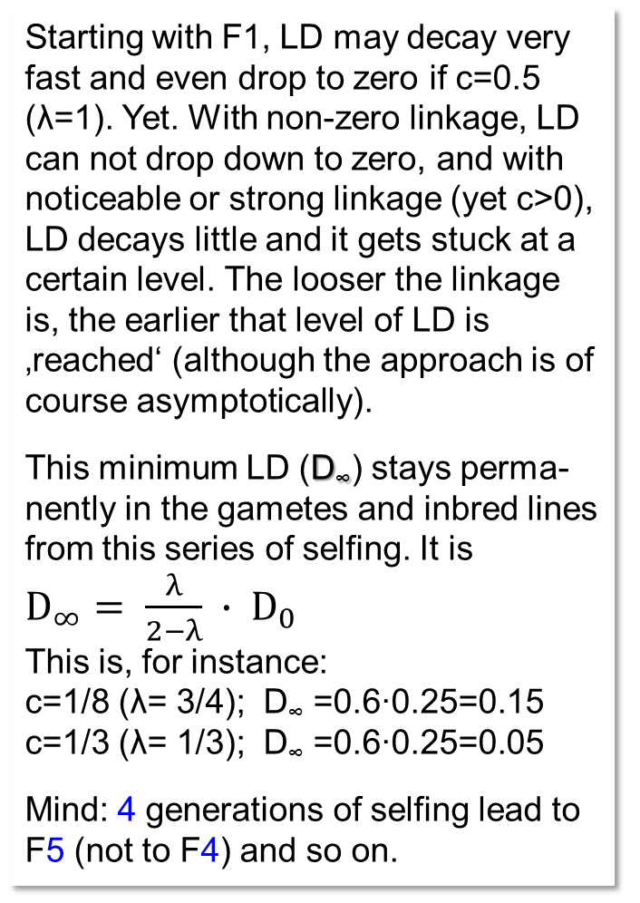
Decay of LD (Gamete Phase Disequilibrium) in the generations F1, F2, F3 and so on (series of self-fertilization; of course: No Mutation, Selection, Drift)
λ=1-2c
Starting with F1, LD may decay very fast and even drop to zero if c=0.5 (λ=1). Yet. With non-zero linkage, LD can not drop down to zero, and with noticeable or strong linkage (yet c>0), LD decays little and it gets stuck at a certain level. The looser the linkage is, the earlier that level of LD is ‚reached‘ (although the approach is of course asymptotically).
This minimum LD (D∞) stays perma-nently in the gametes and inbred lines from this series of selfing. It is
$D_{∞}= \frac{λ}{2−λ} ∙ D_{0}$
This is, for instance:
c=1/8 (λ= 3/4); D∞ =0.6∙0.25=0.15
c=1/3 (λ= 1/3); D∞ =0.6∙0.25=0.05
Mind: 4 generations of selfing lead to F5 (not to F4) and so on.
D
DOI 10.1016/0040-5809(73)90013-0
26

Slide 27
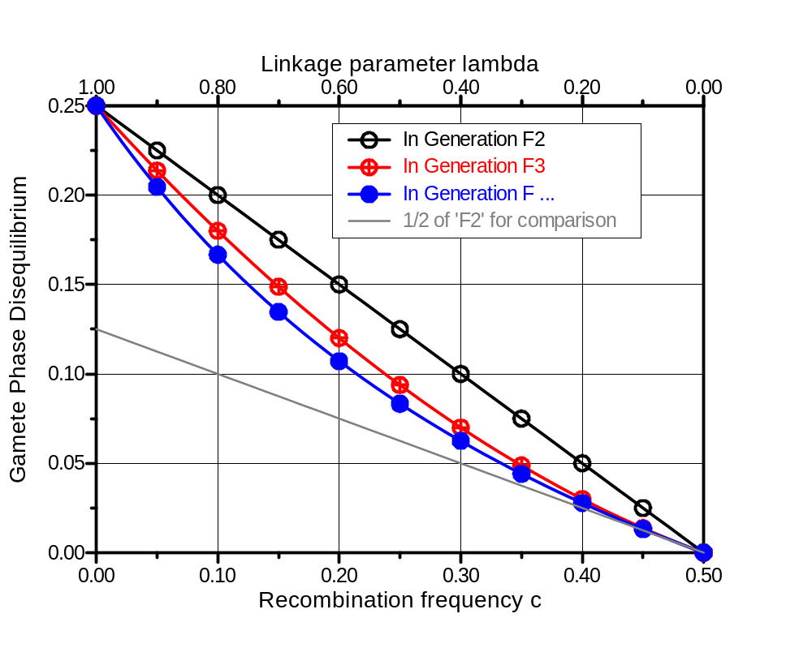
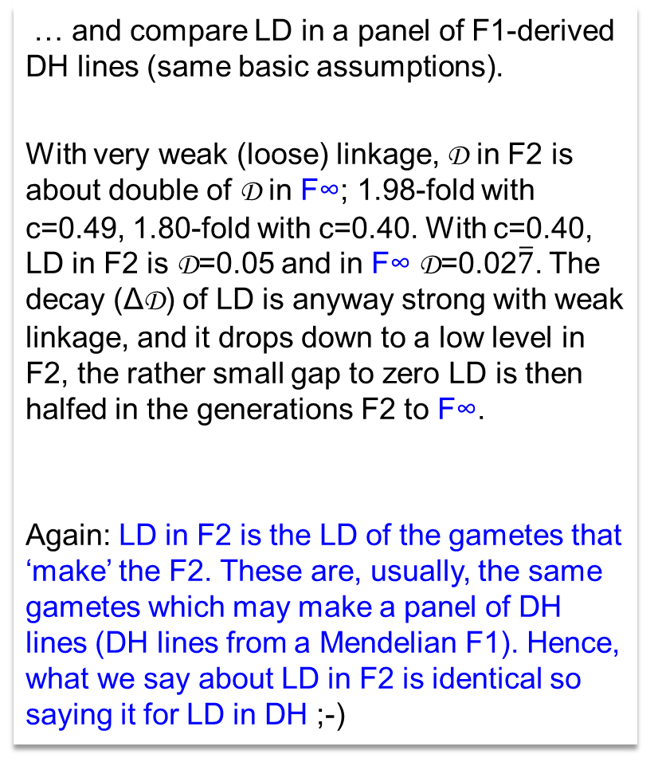
Compare LD in F2 vs. in F∞ (after many generations selfing; no Drift-Mut.-Selection). In reality, F∞ means such as ‚F1-derived full bulk in F6’ or beyond, often termed ‚RIL‘; …
λ
… and compare LD in a panel of F1-derived DH lines (same basic assumptions).
With very weak (loose) linkage, D in F2 is about double of D in F∞; 1.98-fold with c=0.49, 1.80-fold with c=0.40. With c=0.40, LD in F2 is D=0.05 and in F∞ D=0.02$\overline{7}$. The decay (ΔD) of LD is anyway strong with weak linkage, and it drops down to a low level in F2, the rather small gap to zero LD is then halfed in the generations F2 to F∞.
Again: LD in F2 is the LD of the gametes that ‘make’ the F2. These are, usually, the same gametes which may make a panel of DH lines (DH lines from a Mendelian F1). Hence, what we say about LD in F2 is identical so saying it for LD in DH ;-)
D
∞
27

Slide 28
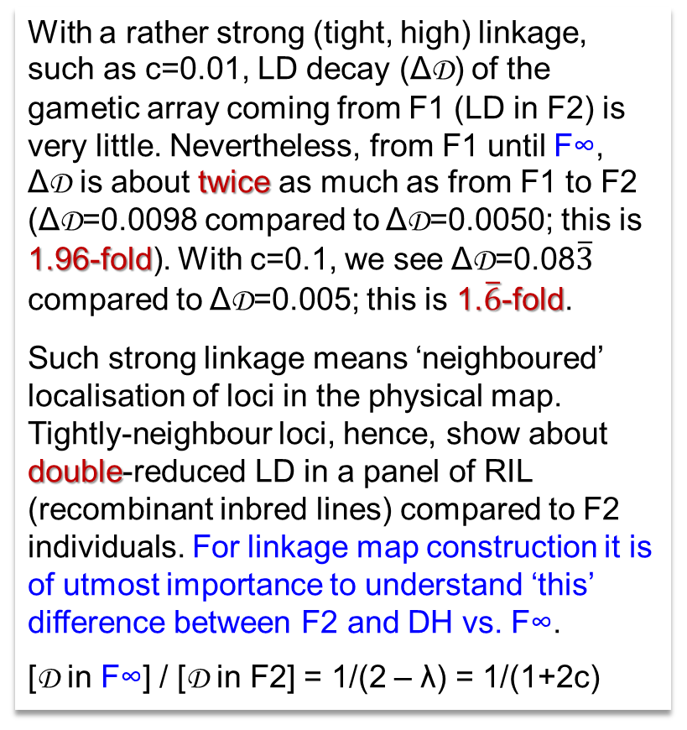
Compare LD in F2 vs. F∞ (after many generations selfing; no Drift-Mutation-Selection). In reality, F∞ means such as ‚F1-derived full bulk in F6’ or beyond, often termed ‚RIL‘; …
λ
With a rather strong (tight, high) linkage, such as c=0.01, LD decay (ΔD) of the gametic array coming from F1 (LD in F2) is very little. Nevertheless, from F1 until F∞,
ΔD is about twice as much as from F1 to F2 (ΔD=0.0098 compared to ΔD=0.0050; this is 1.96-fold). With c=0.1, we see ΔD=0.08$\overline{3}$ compared to ΔD=0.005; this is 1.$\overline{6}$-fold.
Such strong linkage means ‘neighboured’ localisation of loci in the physical map. Tightly-neighbour loci, hence, show about double-reduced LD in a panel of RIL (recombinant inbred lines) compared to F2 individuals. For linkage map construction it is of utmost importance to understand ‘this’ difference between F2 and DH vs. F∞.
[D in F∞] / [D in F2] = 1/(2 – λ) = 1/(1+2c)
0.00
D
∞
0.05
0.10
Decay of LD, ΔD
0.15
0.20
0.25
28

Slide 29
From here you may go to #13. To UNPLAB-h²_GxE_Ch-1[Broad Sense h²]; we now leave Population Genetics.
29
29

